Slide 1
NLP Introduction
By
Dr S PADMANABHAN

Slide 2
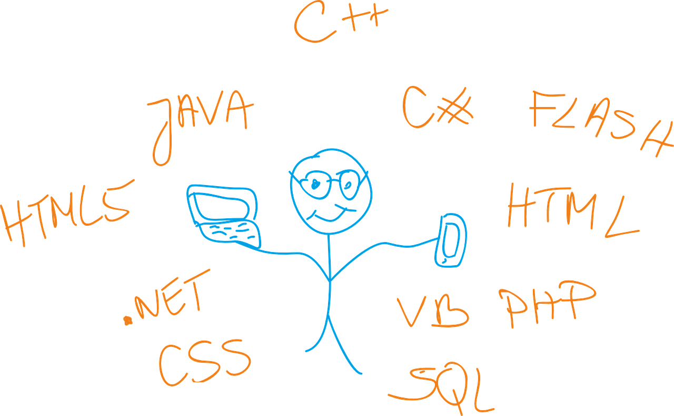
Computers have their own languages!

Slide 3
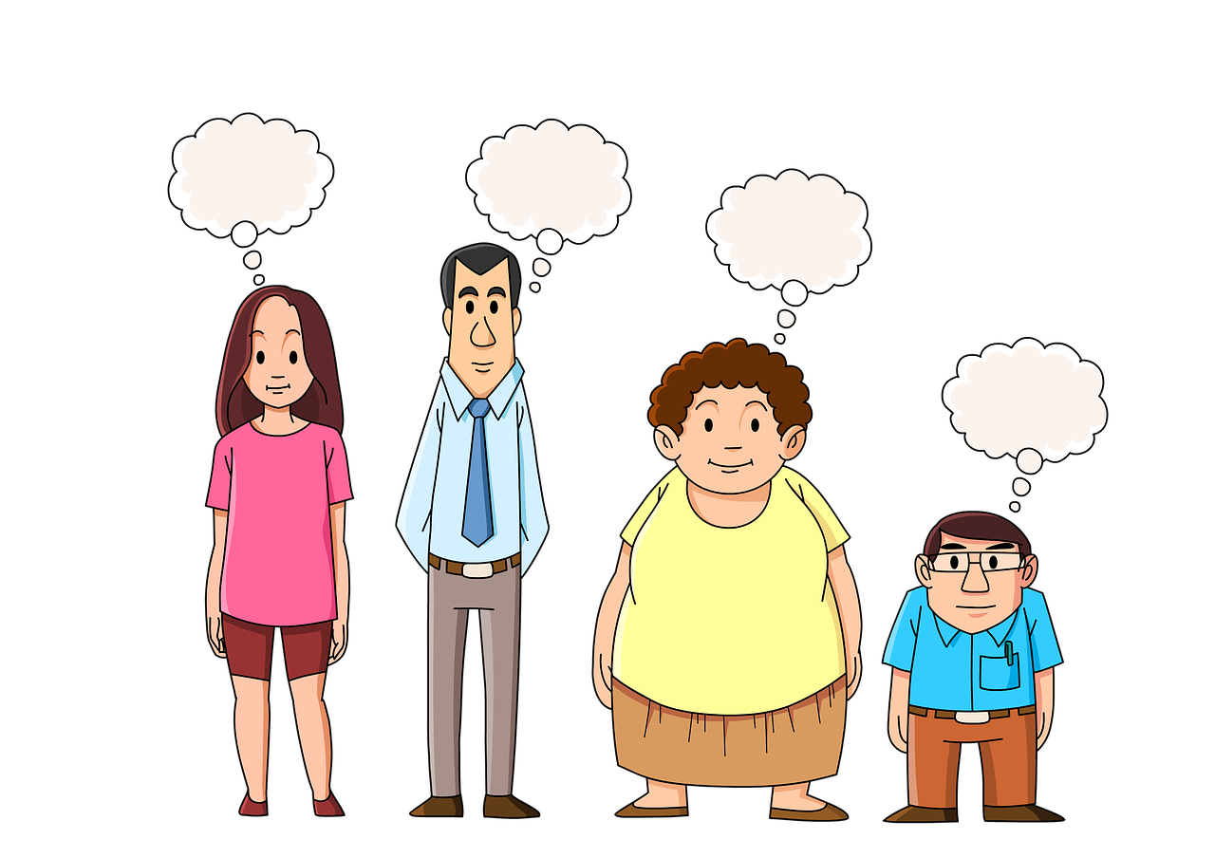
And we humans have our own languages ...called Natural Language

Slide 4

If we have to ask questions to Computer . . like
What is the next train to Delhi after 9pm?
What genes are associated with Diabetes?
What are people liking about our new product?
How much time I have before my next meeting?
We have to convert it to Computer’s language

Slide 5

Wouldn’t it be nice if computers can also use natural language . . .
That’s the goal of NLP

Slide 6
Computers
Linguistics
NLP
NLP is a multidisciplinary field involving
Computer Science and Linguistics

Slide 7
What is Natural Language Processing (NLP)?
Natural Language Processing (NLP) is a field of artificial intelligence (AI) focused on the interaction between computers and humans using natural language.
It involves the development of algorithms and models that enable machines to understand, interpret, and generate human language in a way that is both meaningful and useful.

Slide 8

Why is NLP hard?

Slide 9
He approached many banks for the loan.
Delhi is situated on the banks of Yamuna river.

Slide 10
So how do we build logic to do NLP?
It’s very hard for us humans to build the rules . . (to code)
Hence, we commonly use Machine Learning for NLP

Slide 11
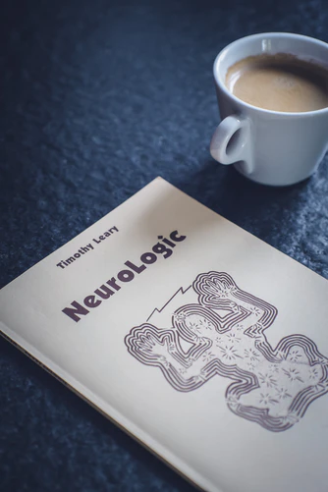
NLP presents a huge opportunity …
as most organization have humongous amount of textual data but struggling to get value out of it.

Slide 12
Manufacturing
Fashion
Healthcare
Banking
&
Insurance
Retail
Travel
Social Media
NLP is useful for every industry …

Slide 13
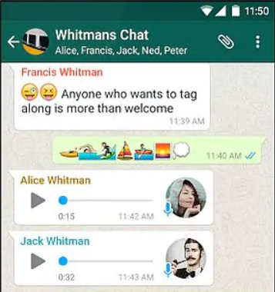
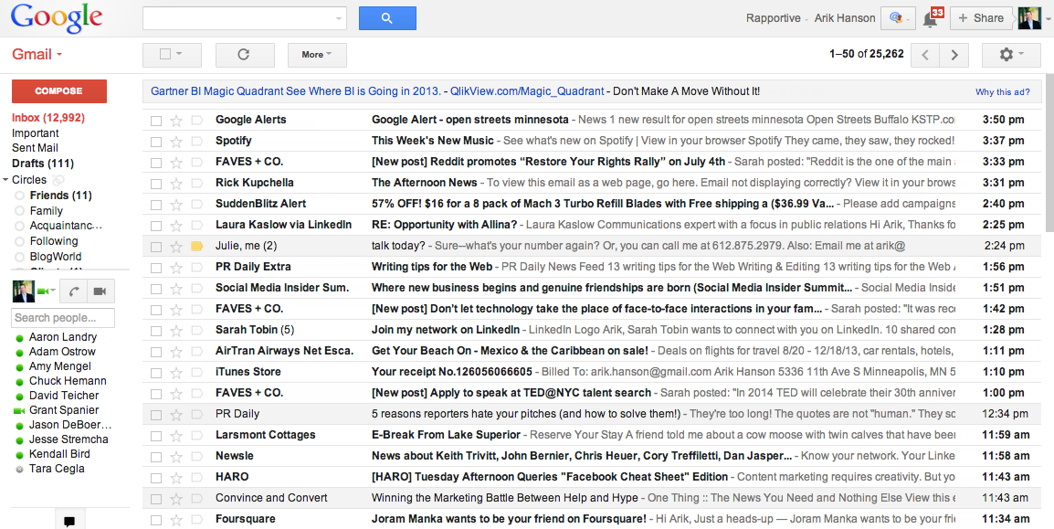
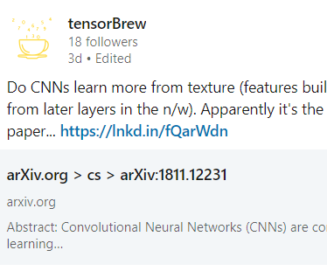
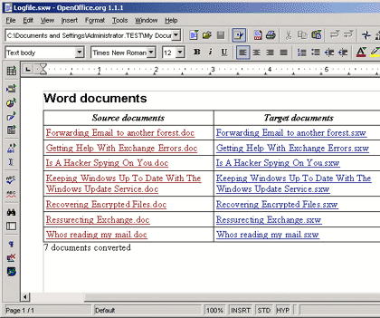

Emails
Social Media Updates
Chat interactions
Office documents
...other audio data
Some examples of Language Data

Slide 14
Applications of NLP

Slide 15

Google Home, Alexa etc
Digital assistants

Slide 16

Help us write better
Improved communication

Slide 17
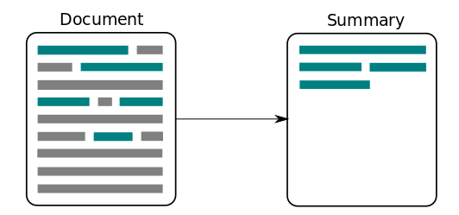
Text summarization

Slide 18

Describe a picture
(Image Captioning)
Tendulkar playing cricket

Slide 19
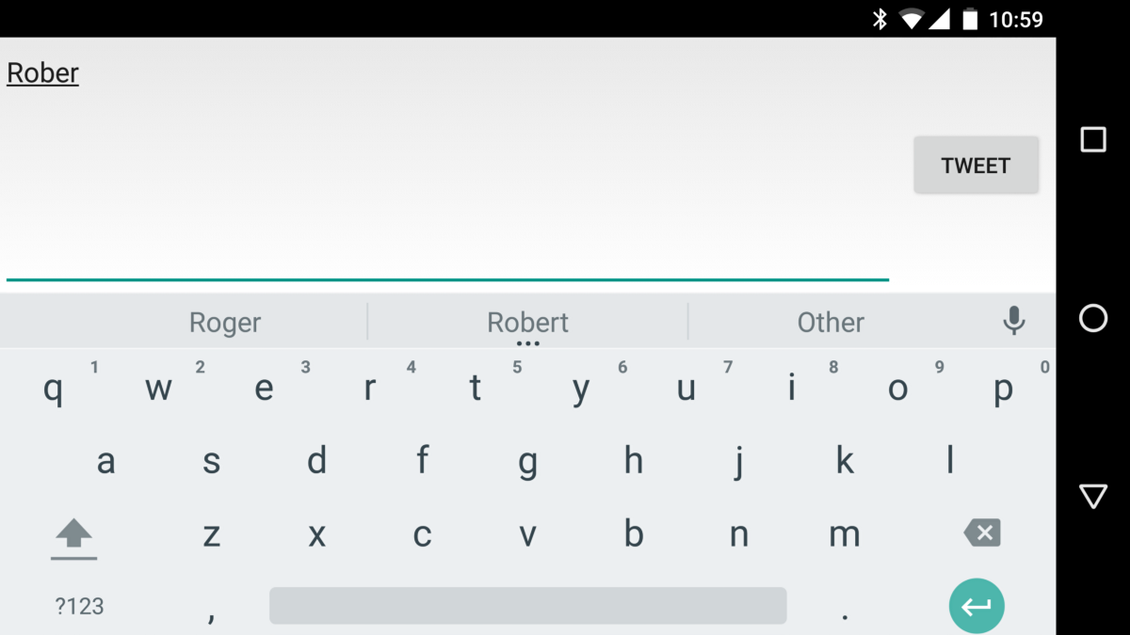
Mobile phone keyboard
Predict next word(s) as we type in...

Slide 20
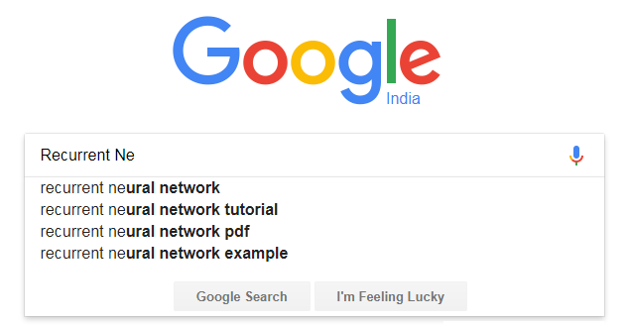
Search suggestions

Slide 21
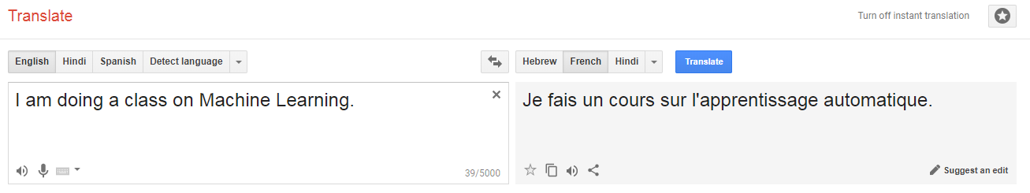
Language translation

Slide 22
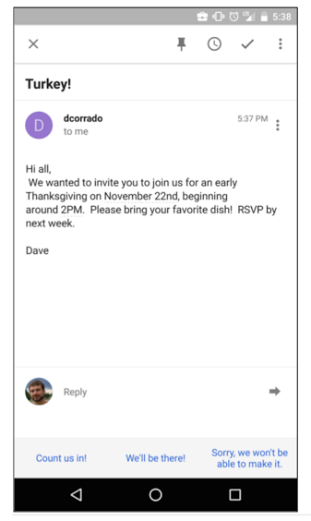
Email Response
Suggested Answers

Slide 23

Chatbots
Make support available in 24x7 format

Slide 24

Sentiment analysis
Do people like our products or Services?

Slide 25

Building NLP Models

Slide 26
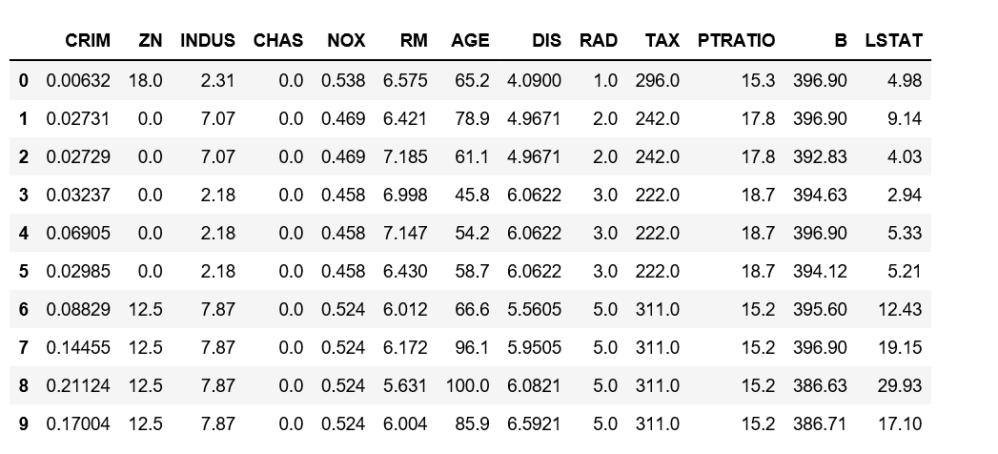
Structured Data
has features (columns)
All records have same features
Features maintain order across examples
Boston Housing Price dataset

Slide 27

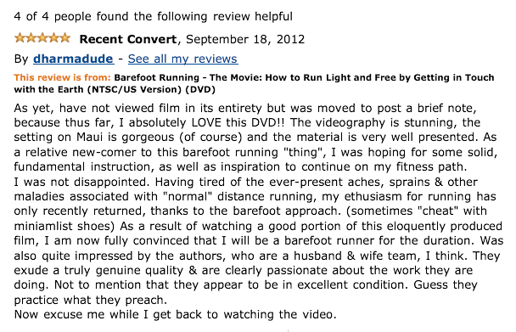
Textual Data
Do not have features like in tabular data.
Examples usually have different size.

Slide 28

What could be the features of textual Data?

Slide 29
Features in textual Data
Words?
Characters?
Combination of words (n-grams)?
What else?

Slide 30
How do we find features of text data?
… Will continue in next PPT

